Slide 1
BOLO Flyer Creator
Danae I. Perez Tillan – Developer
Icxe Vidal – Developer

Slide 2
Problem Definition
BOLOS, or Be On the Look Outs, is a law enforcement term that describes the way information is shared amongst police officers and between police agencies.
First responding police officer does not usually have the capability or time to create such flyer. Flyers are commonly created by detectives or analysts several days after the incident was reported.
The distribution is via email so there is no central, searchable database. If you are not on the email distribution list, you don’t get the BOLO flyer.
The is not way for them to attached a video to the BOLO flyer.

Slide 3
Current System
A BOLO is distributed in several ways:
Over the police radio: When an incident occurs the responding officer will “BOLO” pertinent information over the police radio for other units to hear.
Via Computer Aided Dispatch (CAD) message: The officer will send a text only message via the CAD to other police units that are currently on duty.
A BOLO Flyer (Document) with pertinent information, to include pictures, is created, usually via MS WORD and then converted to PDF and distributed to other officers or agencies via Email or FAX.

Slide 4
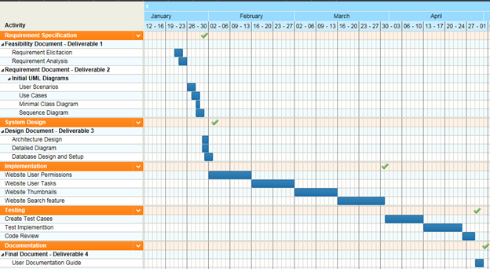
Gantt Chart

Slide 5
User Stories
Create BOLO
User Management
User Permissions
User Groups
Login
BOLO Flyer View
Upload Picture
Search Page
Navigation Menu
Thumbnails Preview
Publish BOLO
Edit BOLO
Send Notifications
Deploy Beta
Delete BOLO
Purge Option
Edit/User Groups Improved

Slide 6
User Stories Cont.
Mobile Version
Archive BOLO
No Image Available
Banners
Search/User Groups Improved
View Full Image
Homepage/User Groups Improved
Search Results as Thumbnails
Edit/Update Option
Continue Beta site support
Video Link Field
Opt in and out of notifications
Save as PDF
Continuous pages
Sort Users by agency
Edit Record Tracking
Log out button

Slide 7
Use Cases
Bolo-001-Log in
Bolo-002-Log out
Bolo-004-Edit Bolo
Bolo-005-Create Bolo
Bolo-006-Thumbnails
Bolo-007-save as pdf
Bolo-008-Search
Bolo-009-Next Button on Homepage
Bolo-013-User Management
Bolo-014-Bolo flier view
Bolo-015-Navigation menu
Bolo-016-User groups
Bolo-017-Email Notifications
Bolo-018-Purge Bolos
Bolo-019-Archive
Bolo-020-No image available
Bolo-021-View image full size
Bolo-022-Filter thumbnails
Bolo-023-Opt out alerts
Bolo-024-Edit tracking

Slide 8
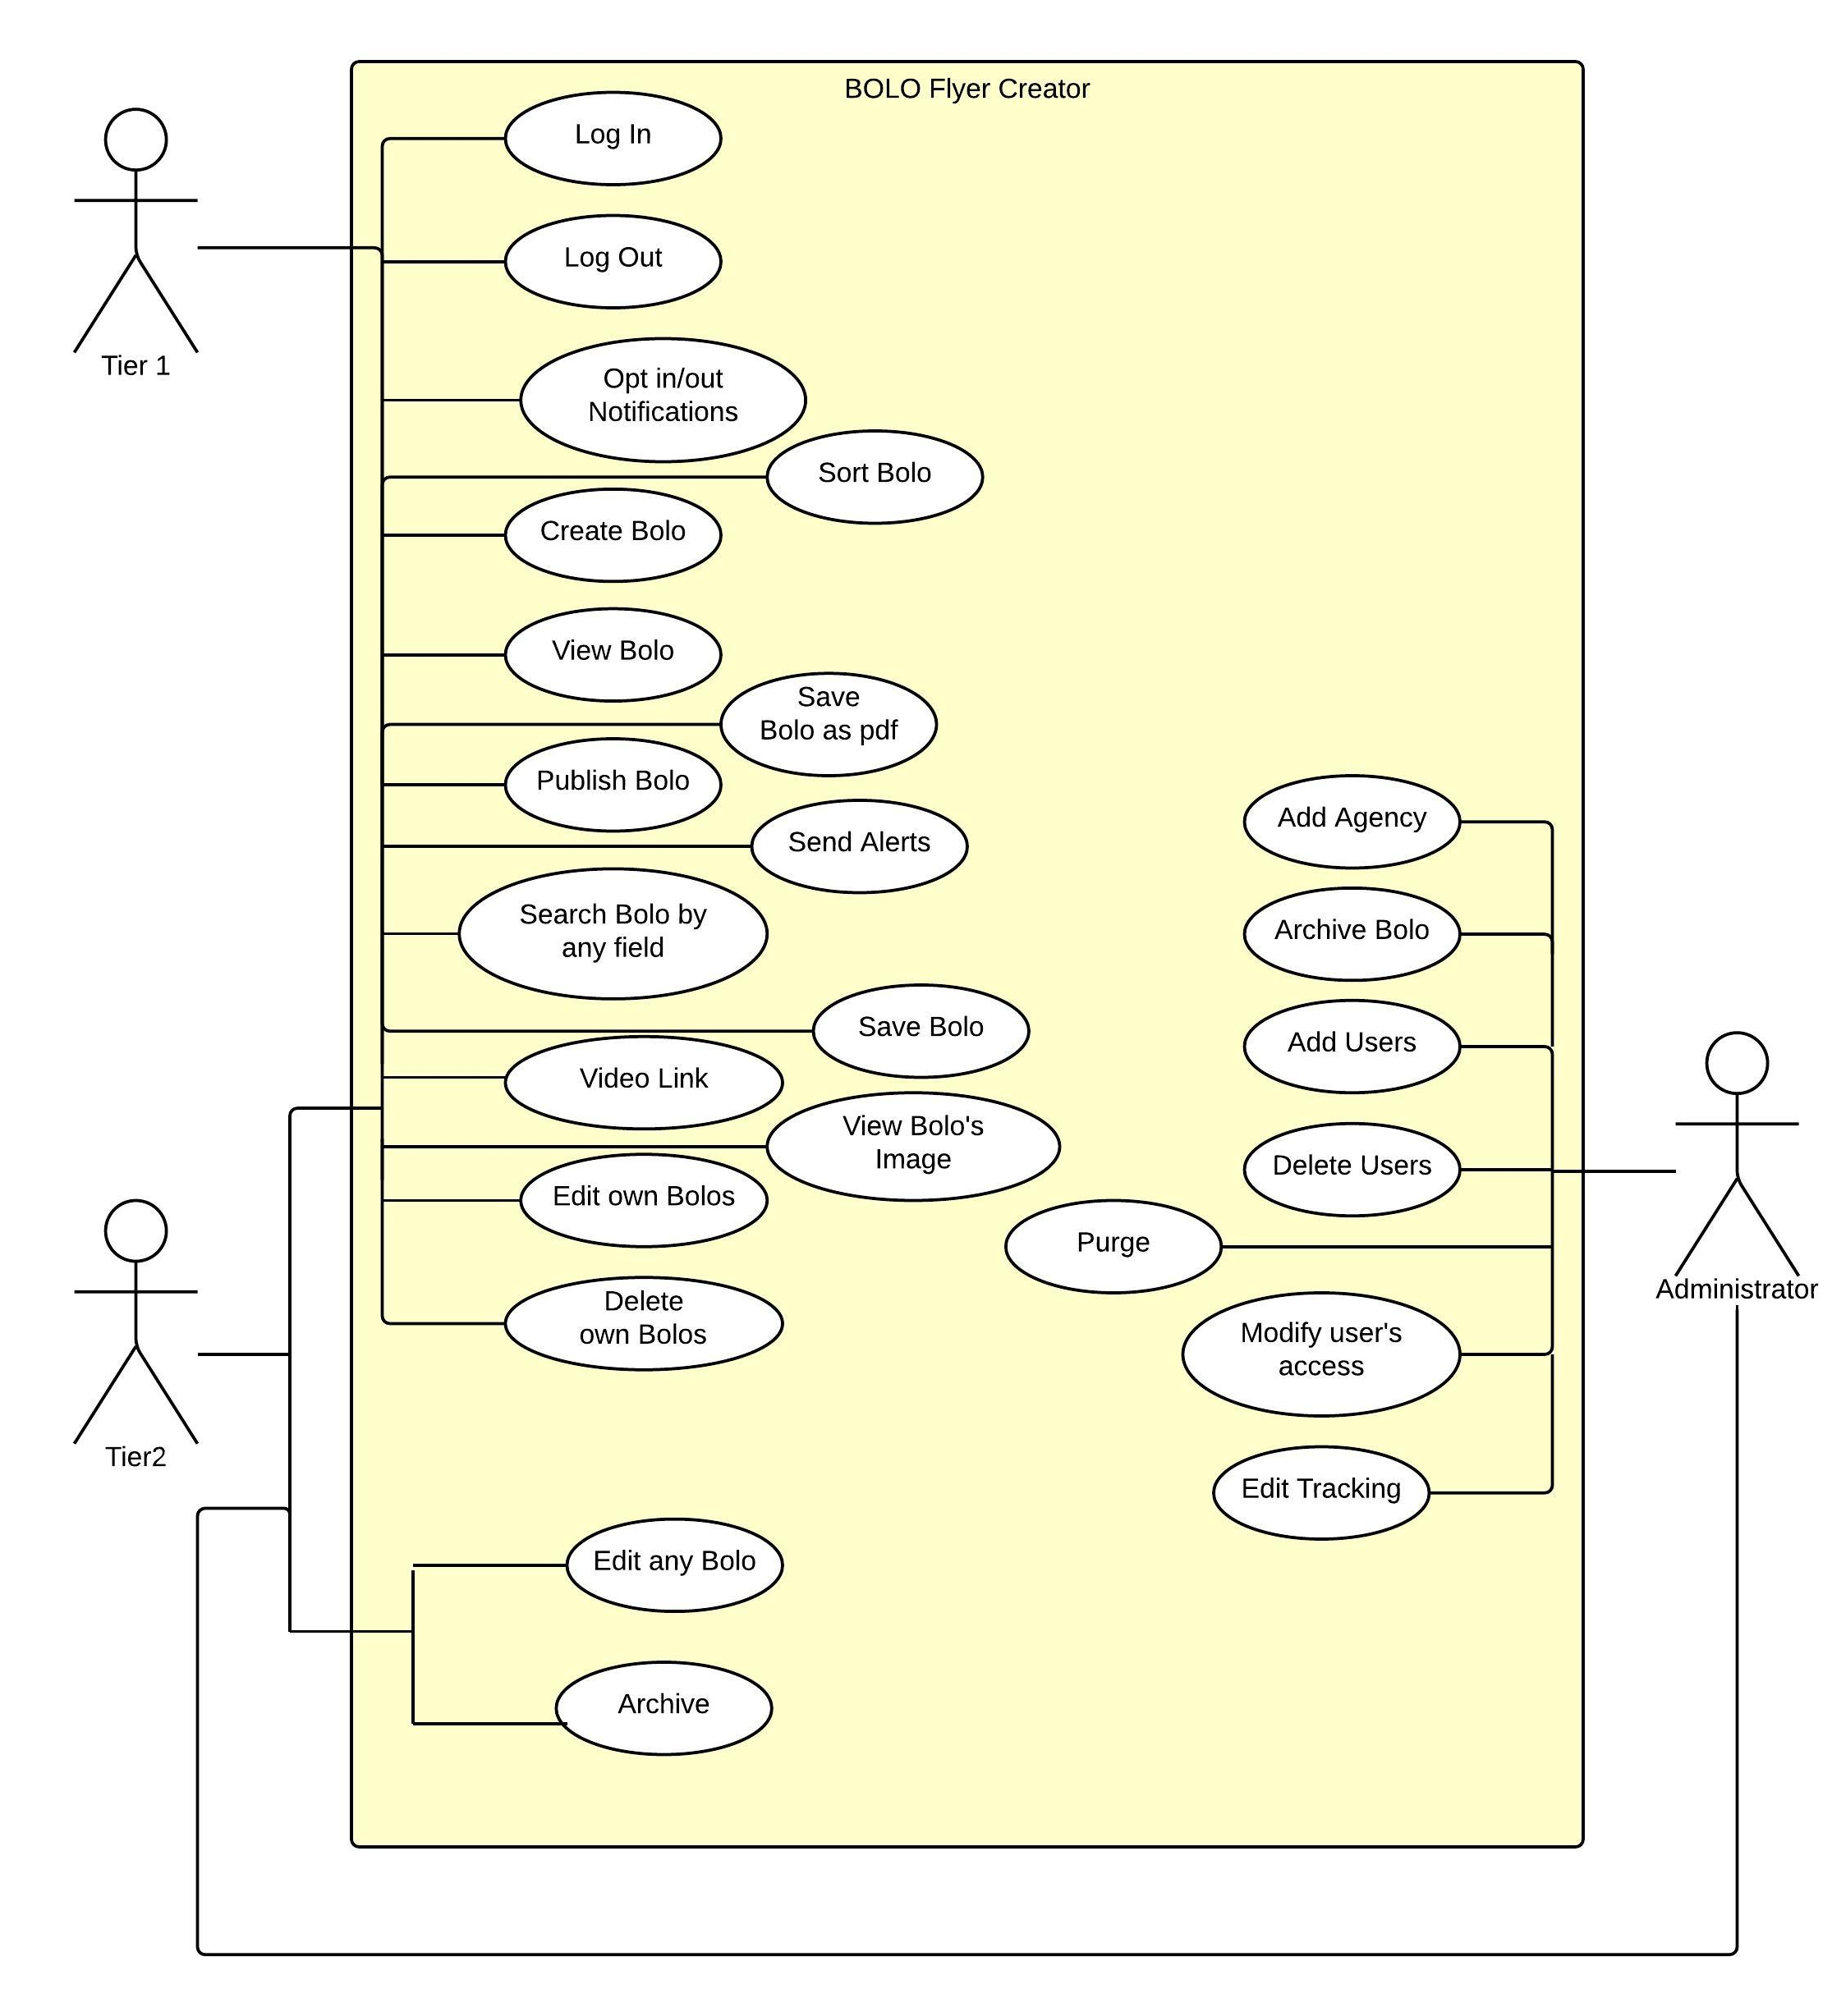
Use Case Diagram

Slide 9
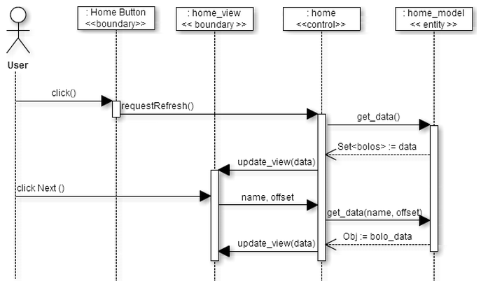
Homepage next and prev buttons
homepage next and prev buttons

Slide 10
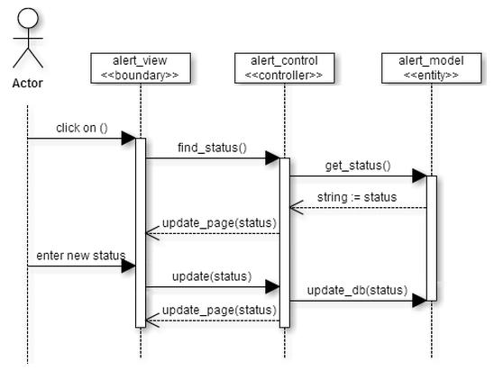
Opt out/in of notifications

Slide 11
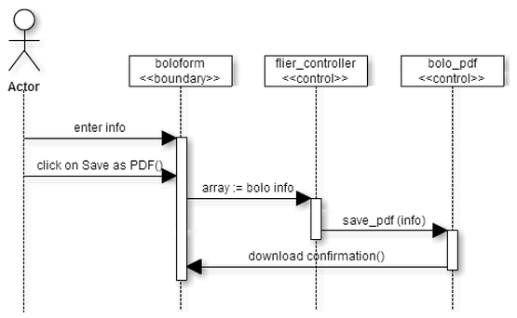
Save as PDF

Slide 12
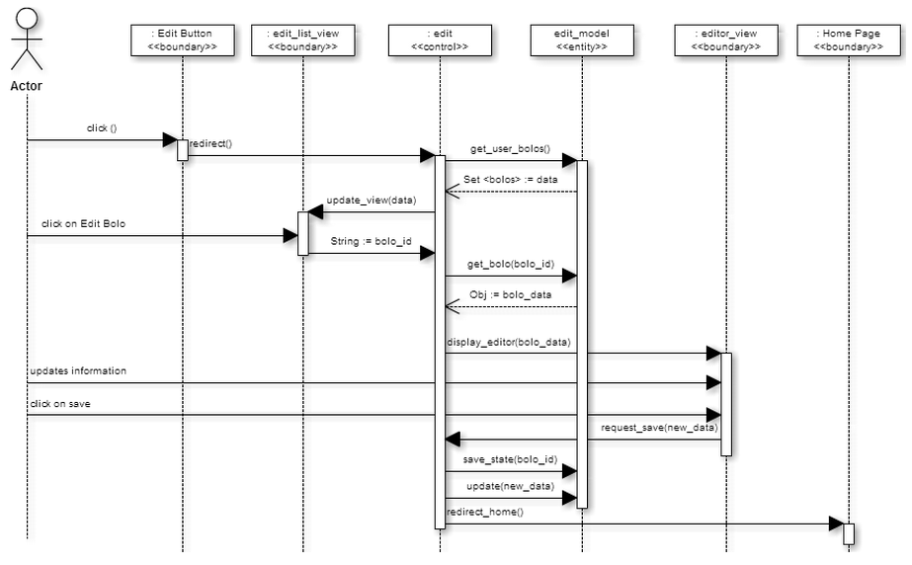
Edit BOLO

Slide 13
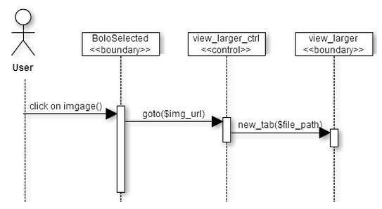
Open image full size

Slide 14
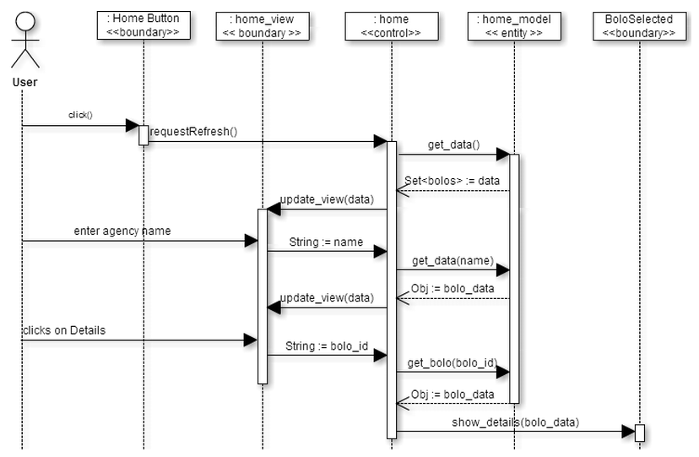
Homepage

Slide 15
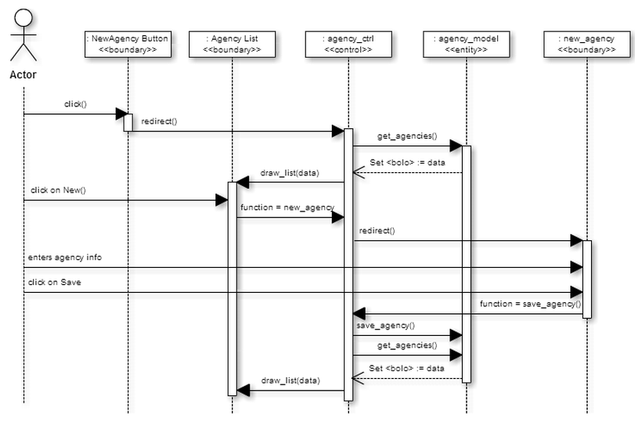
Create new agency(user group)

Slide 16
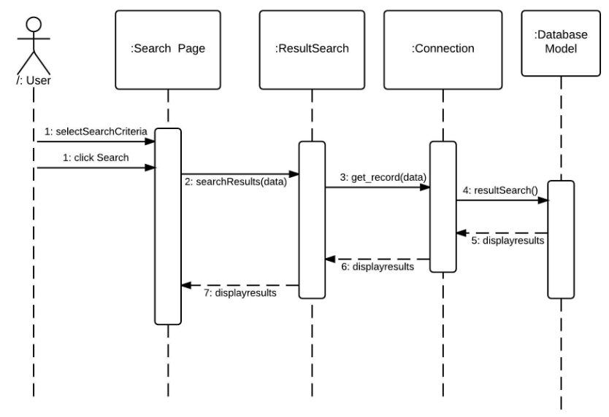
Search BOLO

Slide 17
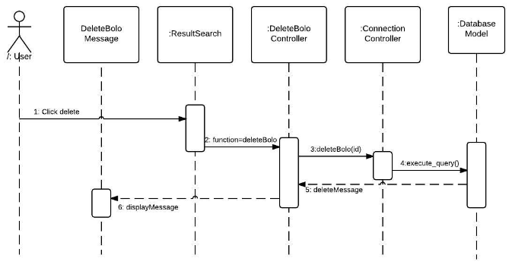
Delete BOLO

Slide 18
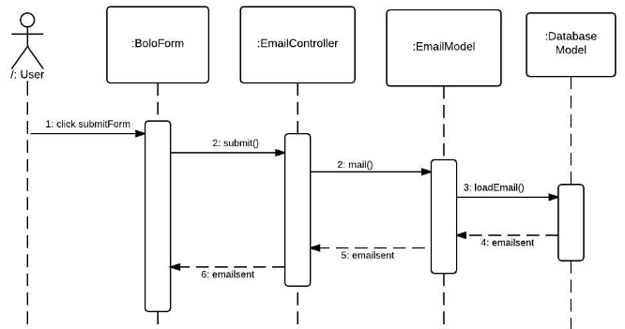
Email Alerts

Slide 19
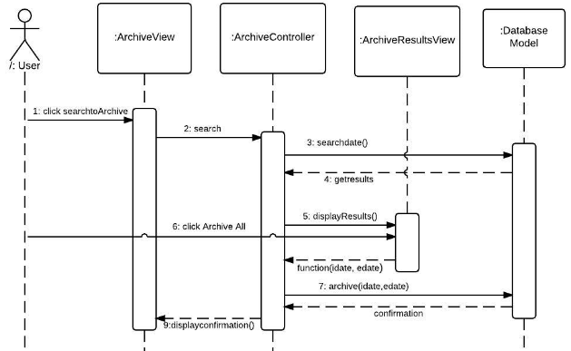
Archive BOLO

Slide 20
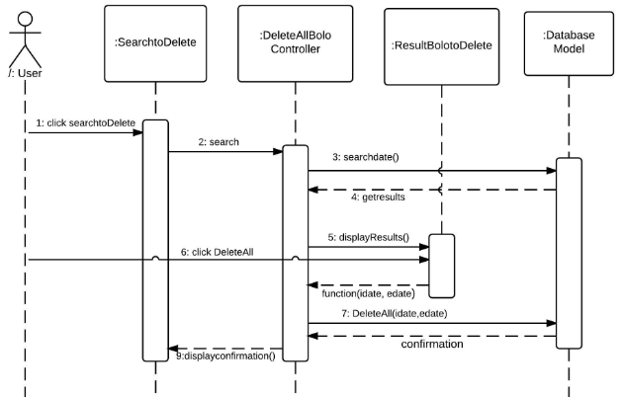
Purge Option

Slide 21
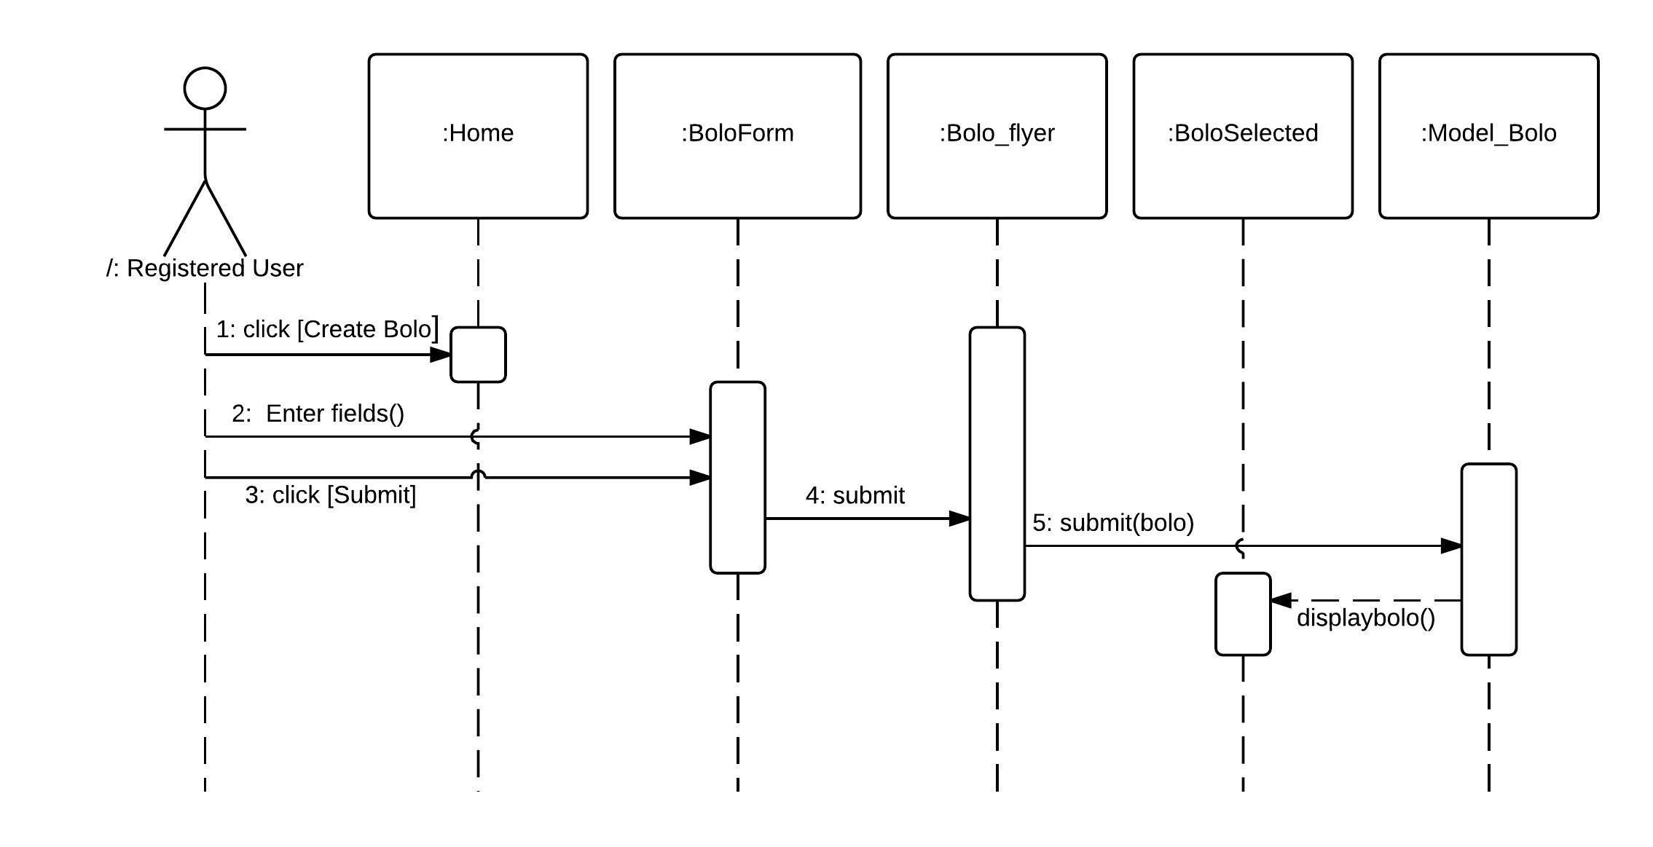
Create BOLO

Slide 22
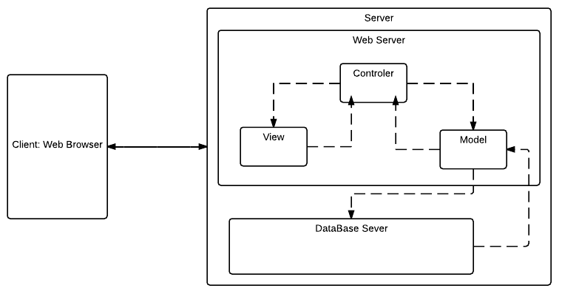
System Decomposition

Slide 23
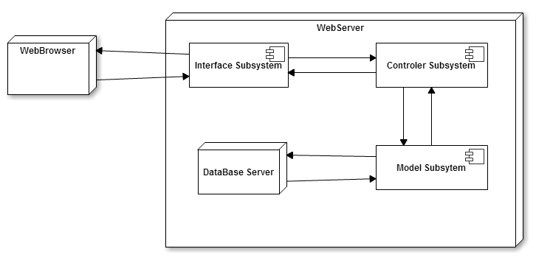
System Deployment

Slide 24
Persistent Data Design
The system will store two kinds of data: a profile for each user containing his name, rank, agency and Tier the user belongs to.
All the information pertinent to each BOLO created: type of BOLO, description of the subject, officer who created, date created, etc.
All BOLO marked as an archived will be saved in another table
Tracking History table

Slide 25
Security/Privacy
SQL Injection The system relies on the WordPress framework for protection against SQL Injection.
Data Encryption: the system encrypts user passwords in the database by using the class phpass
Cross-site scripting: WordPress comes with a Cross Site Scripting Hack prevention filter that filters all POST and COOKIE data
Cross-site request forgery: CSRF is also addressed by enabling the Cross Site Scripting Hack prevention filter

Slide 26
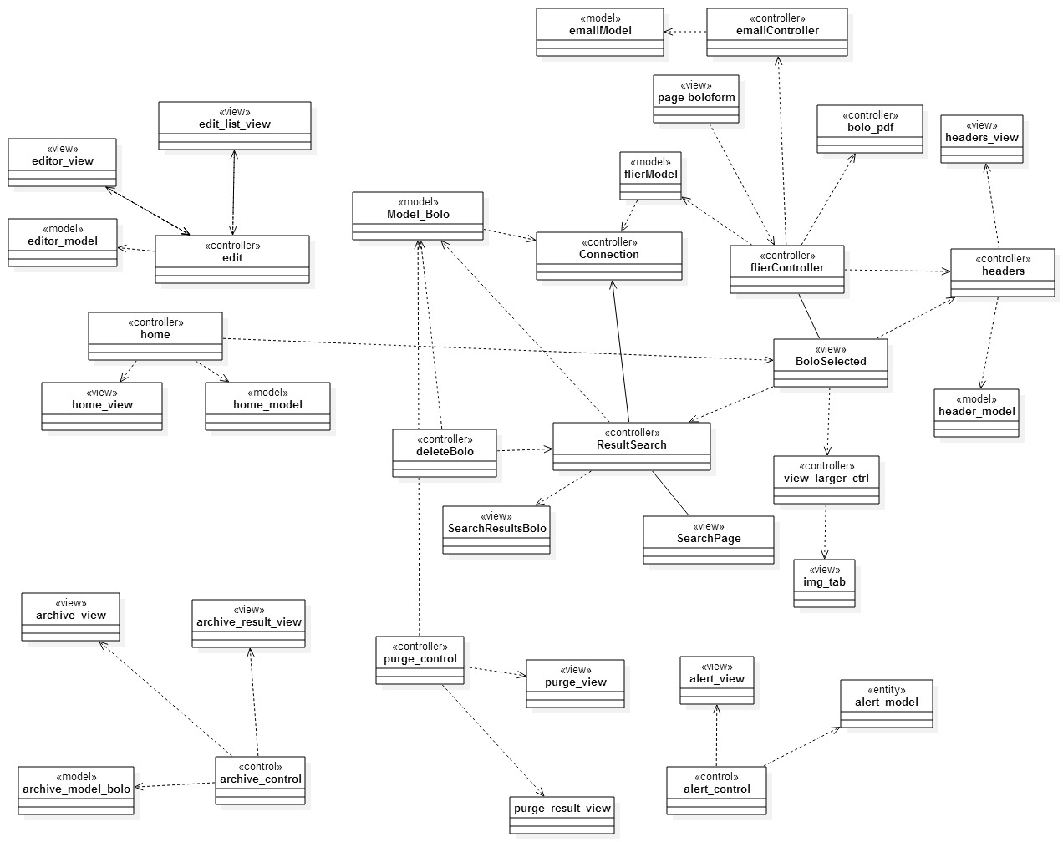
Minimal Class Diagram

Slide 27
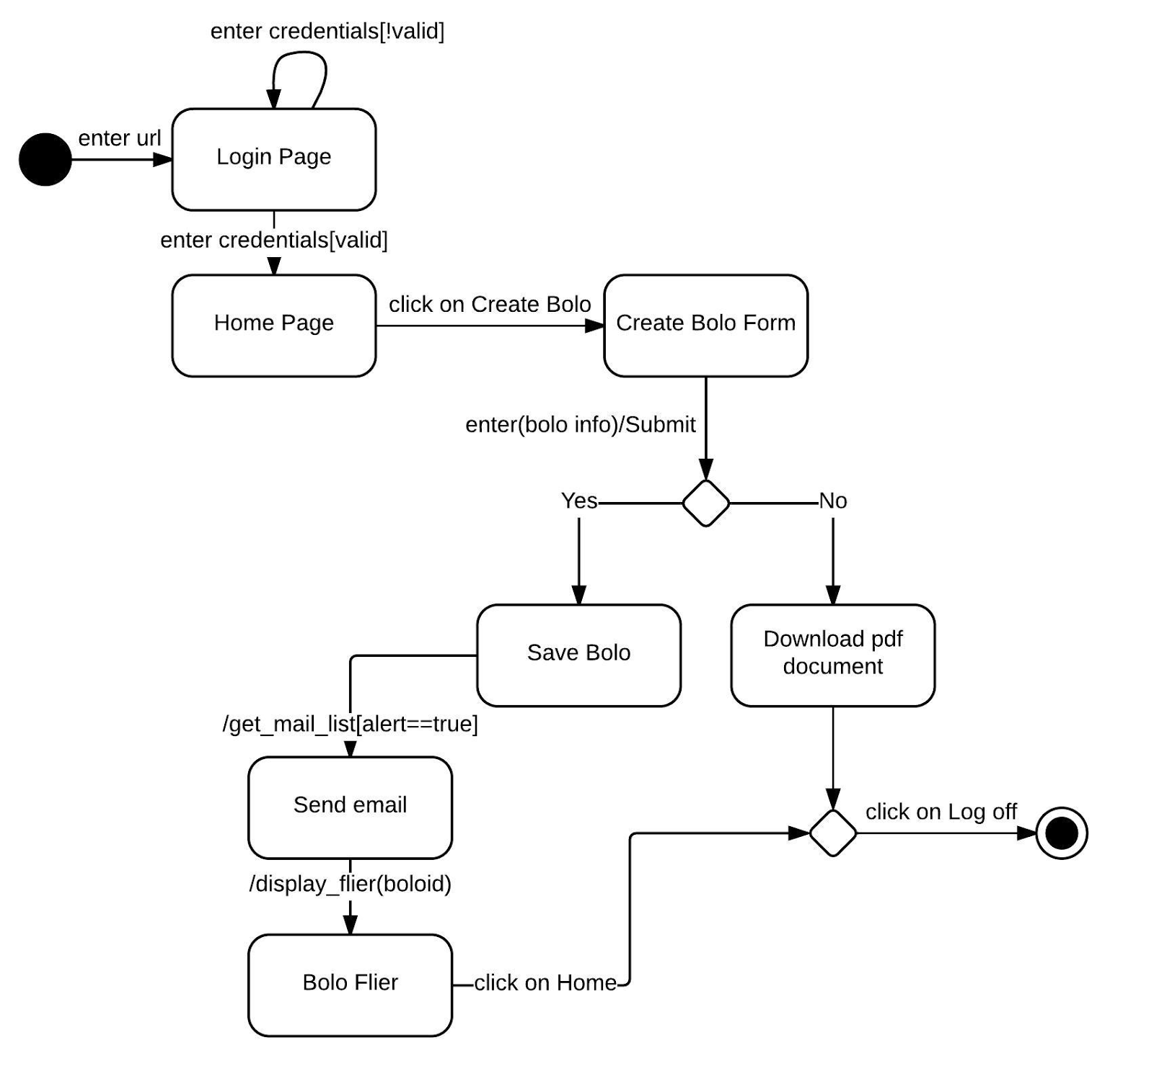
State Machine

Slide 28
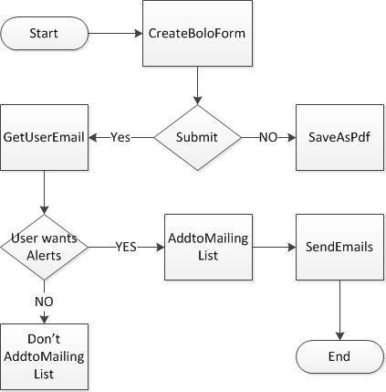
Email Alerts– Algorithm

Slide 29
Test Cases
Test Case ID | BOLO 017 SUNNY1
Purpose | To validate the email notifications functionality
Preconditions | A user has logged in to the system The user has filled a bolo form with the available information
Input | The user clicks on submit
Expected Result | All registered users receive an email with a link to the flier view of the bolo the user just created
Test Case ID | BOLO 017 RAINY
Purpose | To validate the email notifications functionality
Preconditions | A user has logged in to the system The user has filled a bolo form with the available information
Input | The user clicks on Save as pdf
Expected Result | The system downloads a psd version of the bolo, and no email notification is sent

Slide 30
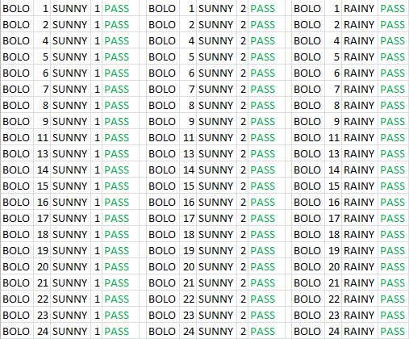
Implemented Use Cases – Sunny/Rainy

Slide 31
Automated Scripts and Demo

Slide 32
Thank You

